Slide 1
ECN Progress review and discussion

Slide 2
Contents
PhD requirements in IITM and ECN
Timeline of PhD
2019
2020
2021
Works left
Conclusion and suggestion

Slide 3
PhD requirements (Jan 2018 - Till)
IITM requirements
To complete PhD
Take 36 credits courses- Completed upto Dec 2018
Completing Comprehensive Examination - Jan 2019
Research Proposal Seminar - Dec 2020
Research Colloquium Seminar
Synopsis submission (Important contribution)
Before Submission atleast one paper to be accepted
Thesis submission
PhD Viva voice
ECN requirements
To complete PhD
Completion of 100 hours of courses (40 Scientific and 60 Professional)
Assuming IIT course works are accepted
2 CSI meeting (minimum)
First CSI meeting on Dec 2020
Second CSI meeting (expecting this July 2020)
2nd Year Research Seminar
To be decided
One International conference and one published article
Thesis submission
PhD Viva Voice

Slide 4
Timeline - First 18 months
(Jan 2018 to June 2019 in IITM)

Slide 5
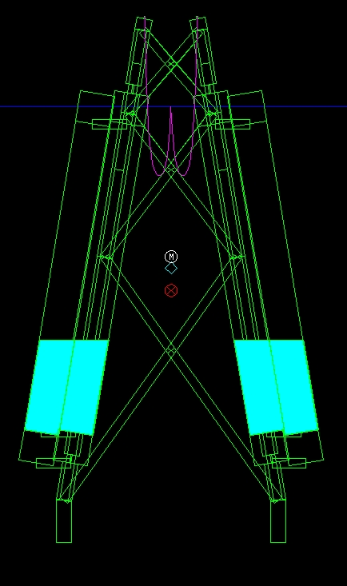
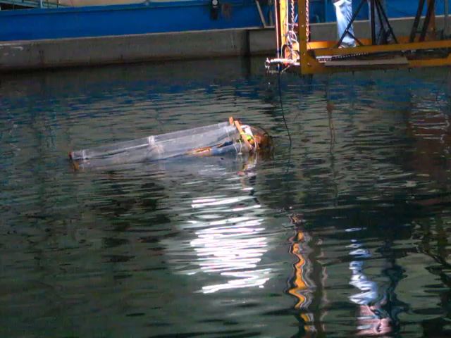
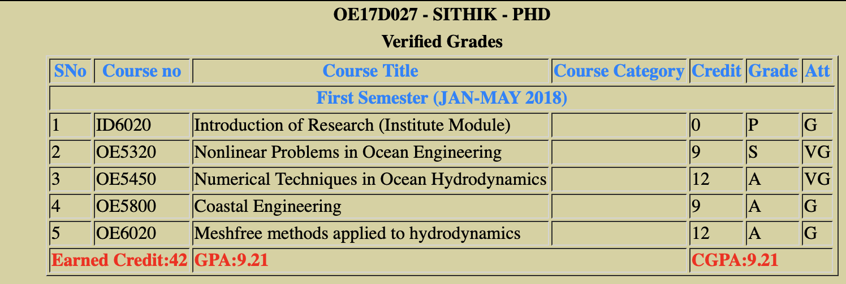
Timeline (Jan 2018 - June 2019)
First year of PhD : Above course works and Comprehensive exam (IITM requirements)
July 2018 - June 2019- DAAD DST Fellowship :
(Submitted, Ocean Engineering) Sithik A, Meyer J, Sriram V, Hildebrandt A, Experimental investigation offshore crane load during upending a wind turbine jacket sub-structure in regular waves, 2019

Slide 6
Timeline - Second 18 months
(June 2019 to Dec 2020 in ECN)

Slide 7
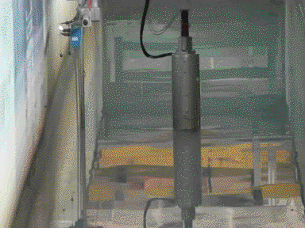
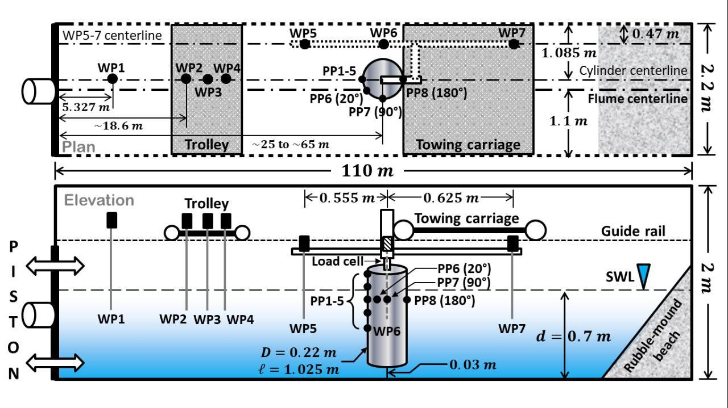
EXPERIMENT (LU Hannover,Germany)
4 types of test cases carried out in similar domain
Test case 1 and 2: Fixed cylinder (Nonbreaking and Breaking focussing wave)
Test case 3 and 4 : Moving cylinder (Nonbreaking and Breaking focussing wave)
Fig: Experiment test case - typical Moving cylinder
Reference :
V. Sriram, S. Yan , Zhihua Xie, Comparative Study on Steep Focused Waves Interactions with Fixed and Moving Cylinder, ISOPE-2020, Shanghai
2. S. Yan, Q.W. Ma, V. Sriram, Ling Qian, P.J.M. Ferrer, and Torsten Schlurmann. Numerical and experimental studies of moving cylinder in uni- directional focusing waves. 2015:711–718, 01 2015.

Slide 8
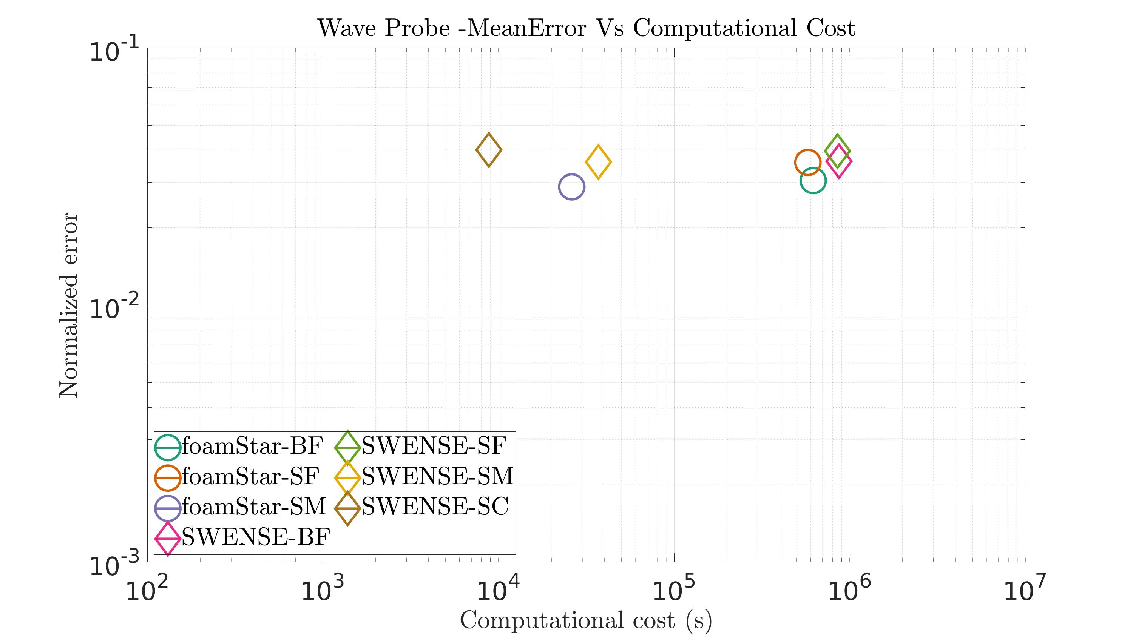
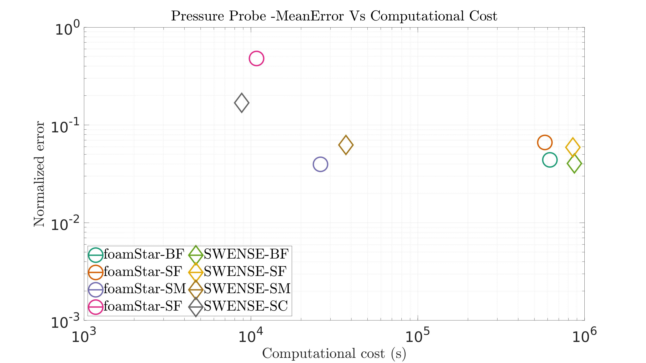
Efficiency Estimation Summary 1
For Coarser Mesh SWENSE is more accurate with less computational time
For medium type mesh foamStar is little more accurate and less computational time
For Finest Mesh - SWENSE is more accurate but takes more computational time than foamStar
Fig: Relative mean Error Vs Computational time for wave probes
between foamStar and SWENSE solvers
Fig: Relative mean Error Vs Computational time for Pressure probes
between foamStar and SWENSE solvers

Slide 9
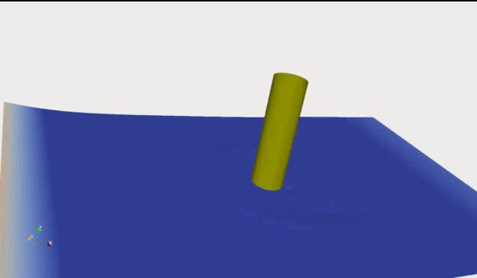
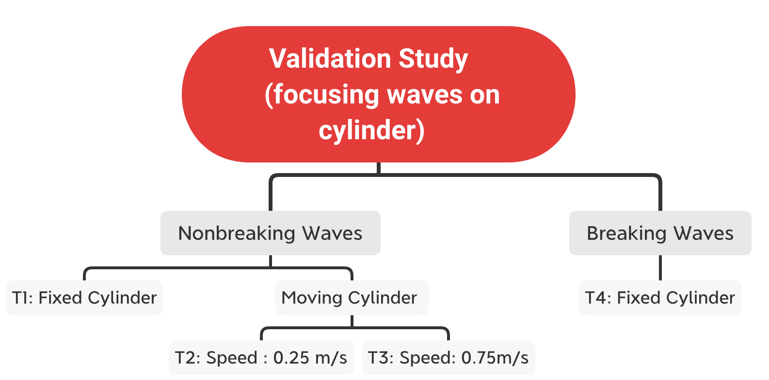
Numerical Analysis
Fig: Free surface contour for ($α$ =0.5) during focusing time on focusing location(ie cylinder)
(IJOPE) Sithik A, Benjamin B, Ducrozet G, Ferrant P, Comparative Study on Steep Focused Waves Interactions with moving Cylinder, IJOPE (2020)
(In preparation) Sithik A, Benjamin B, Ducrozet G, Sriram V, Ferrant P, Investigation of hybrid coupling capability on complex breaking and nonbreaking focusing waves with fixed and moving cylinder interaction, 2021

Slide 10
Timeline - 5 months
(Jan 2021 to May 2021 in ECN)

Slide 11
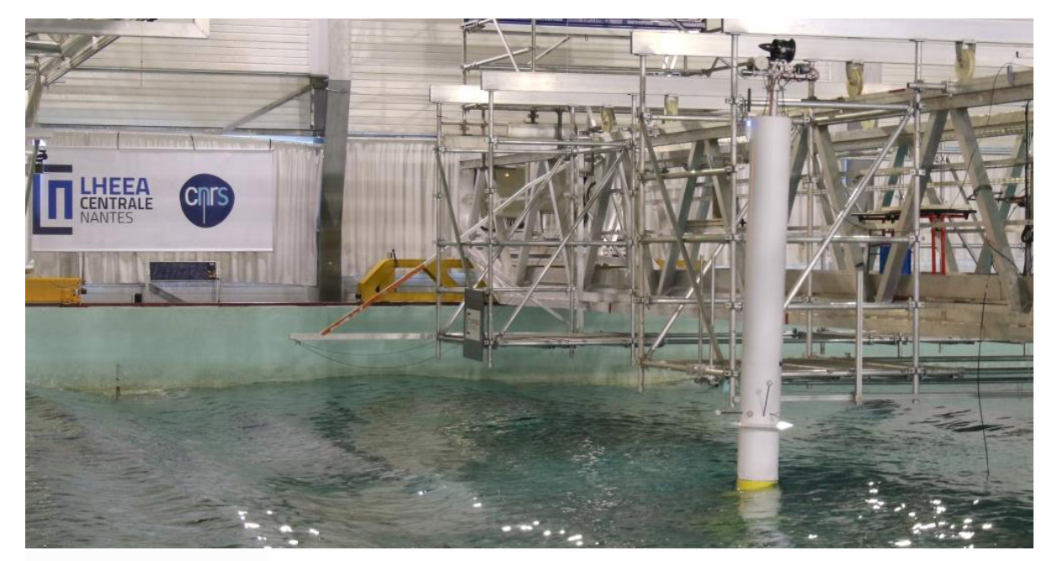
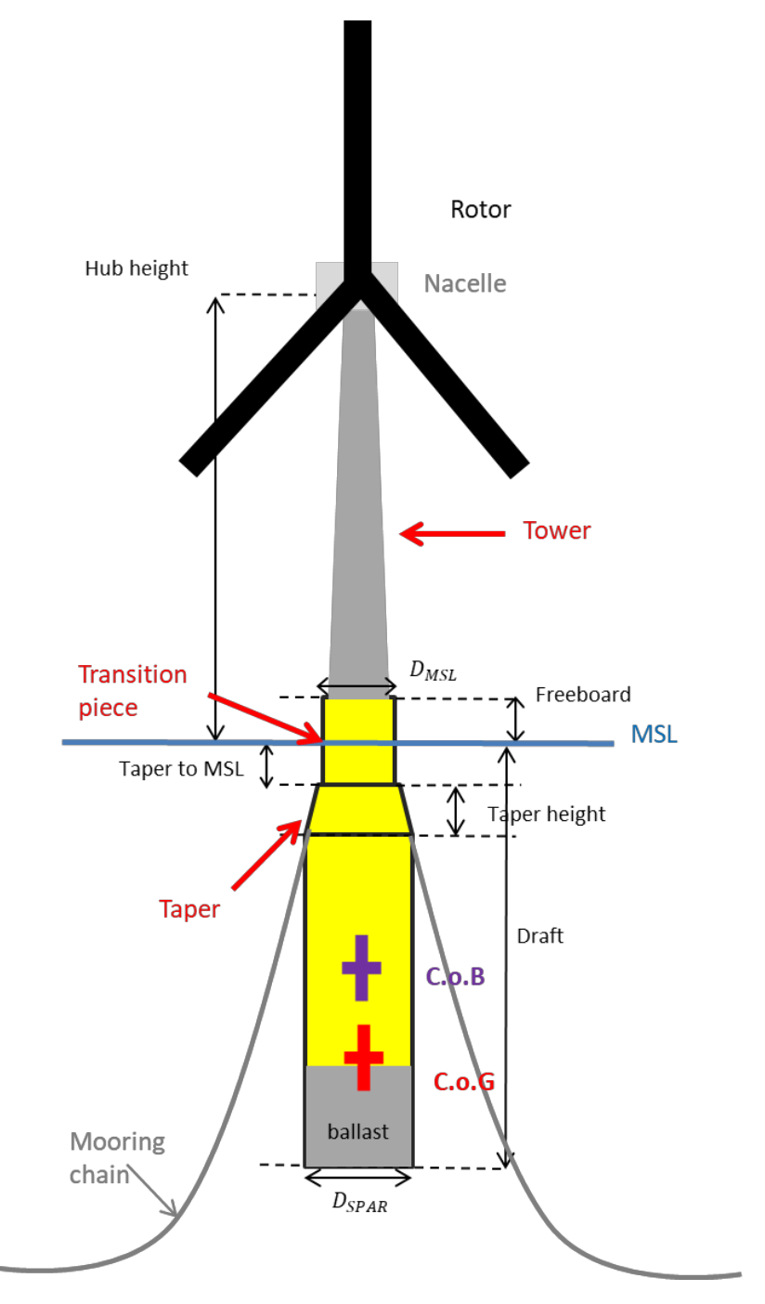
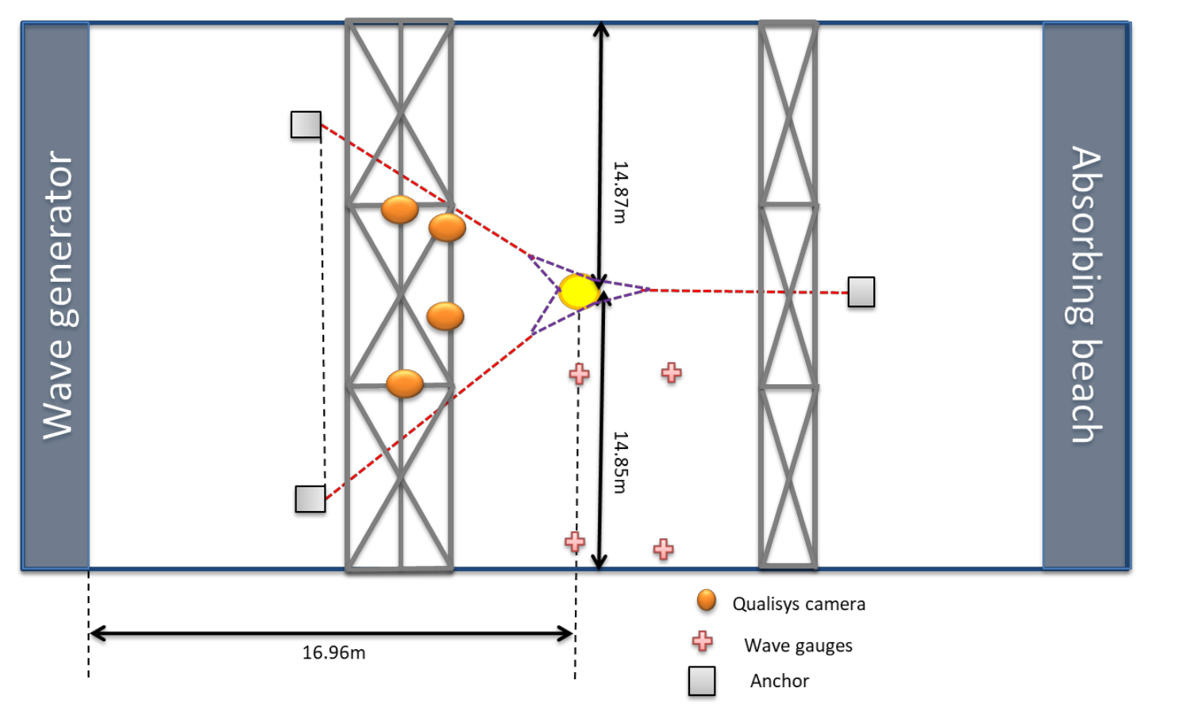
ECN Experiment (Vincent et al 2020)
Floating Offshore Wind Turbine with SPAR floater in multi- segmented Catenary mooring system
TestCases carried in Experiment
Decay tests
Decay tests with waves
Regular waves without wind
Motion RAO
Wave drift forces
Regular waves with speed
Motion RAO
Wave drift forces
Irregular waves and turbulent wind
Properties | Values
Mass (Floater + Tower+ Hub) | 329.73 kg
COG (calculated) | (-0.0043,0,-1.8055)
MOI (calculated) | 190,190,10 (kgm²)
COB | -1.023

Slide 12
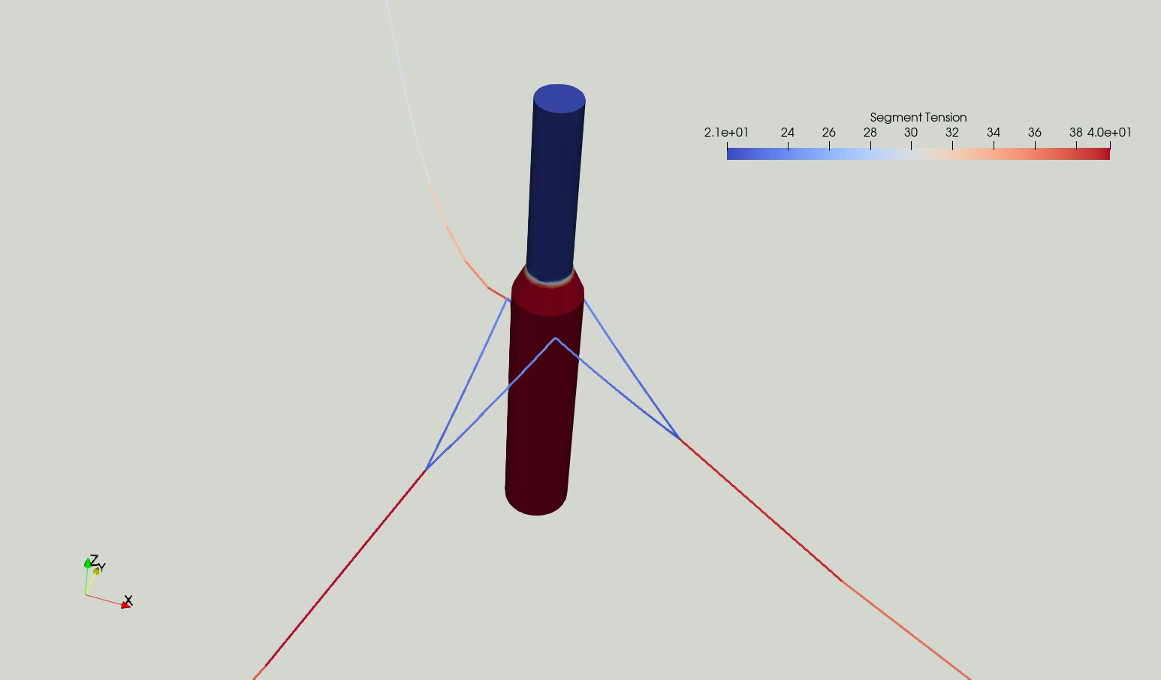
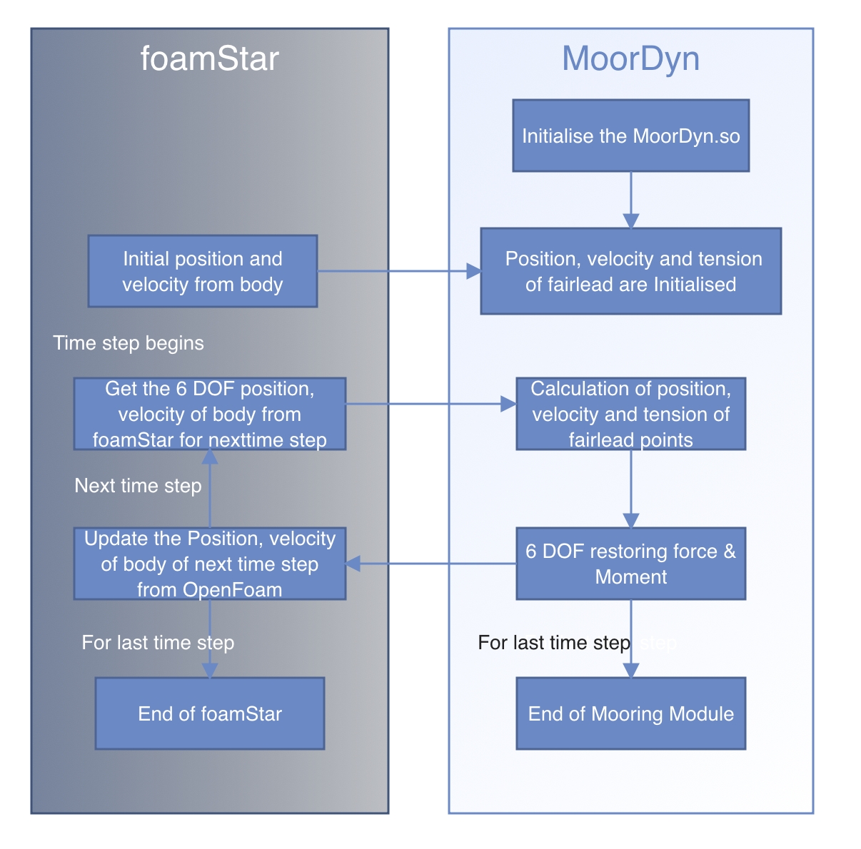
MoorDyn coupling with foamStar
MoorDyn code is modified to accommodate the coupling and also to run in parallel processing
foamstar code is modified to accommodate the coupling as per flow chart (right)
Output of MoorDyn is modified to read in accordance with foamstar output
Fig: Flow chart workflow procedure being carried for coupling foamStar

Slide 13
Current Progress(foamStar)

Slide 14
Possible Outcome
Expecting (based on experience) need another 1 month to complete all the mentioned test cases in SPAR
Possible outcome
(Work in Progress- foamStar case ) Sithik A, Benjamin B, Ducrozet G, Sriram V, Ferrant P, Investigation of hybrid coupling capability (HOS, Openfoam and MoorDyn) on OC3 Floating SPAR in presence of regular and irregular waves, 2021
Same work I am interested in doing in SWENSE to evaluate its capability and publish separately
Also from my earlier experiment (Slide 7), I wish to validate one time series in foamStar (Need your vision) so I can include that work in the PhD.

Slide 15
Questions for discussion

Slide 16
discussion
Does this enough for PhD content?
Time line for CSI 2, Seminar and Thesis submission
Planning Defence along with IITM
Working conditions from India for another 6 months
Any other deadlines

